Slide 1

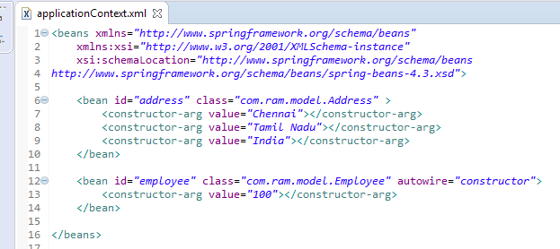
Constructor auto-wiring mode
In case of constructor auto-wiring mode, spring container injects the dependency by highest parameterized constructor.
If you have 3 constructors in a class, zero-arg, one-arg and two-arg then injection will be performed by calling the two-arg constructor.

